Slide 1
Adjustable Block Program Lottery Stakeholder Meeting Sep 17th, 2018

Slide 2
Meeting Format
-Short presentation followed by questions and comments
-All questions and comments are via the chat function
-All questions will be read aloud and answered by Administrator or IPA staff

Slide 3
Stakeholder Process
-Stakeholder document released Monday, Sep 10th
-Stakeholder webinar Monday, Sep 17th
-Comments taken at comments@illinoisabp.com from Sep 10th to Sep 28th
-Administrator and IPA staff will review comments and release the final lottery procedure at www.illinoisabp.com
Notes:
-Please restrict your questions and comments today to the lottery process. The administrator will be happy to answer any questions about other issues at admin@illinoisabp.com or (877) 783-1820
-Three future stakeholder processes will cover approved vendor requirements and consumer protection, community solar requirements and consumer protection, and all other program guidelines
-Please follow up with an email with any comments you make during the presentation today
-All comments received will be made publicly available unless the commenter specifically requests confidential treatment and submits a confidential and redacted version.
-A recording of this presentation and a copy of the slides will be available shortly after the meeting concludes at www.illinoisabp.com

Slide 4
Proposal

Slide 5
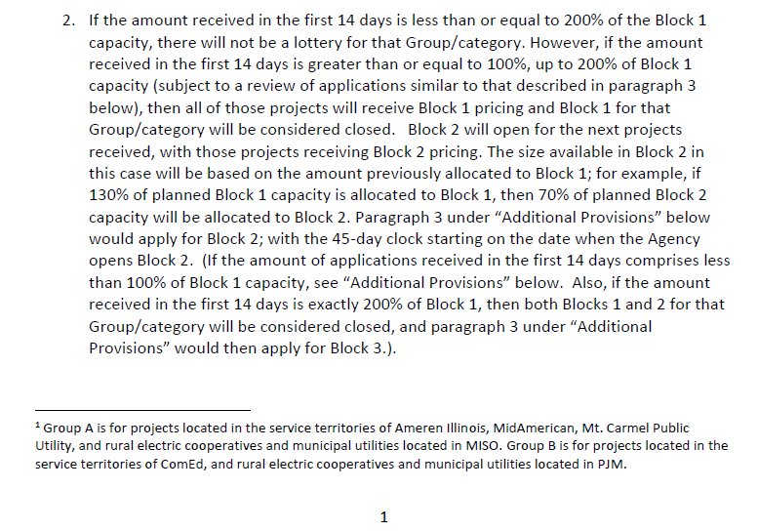
Proposal

Slide 6
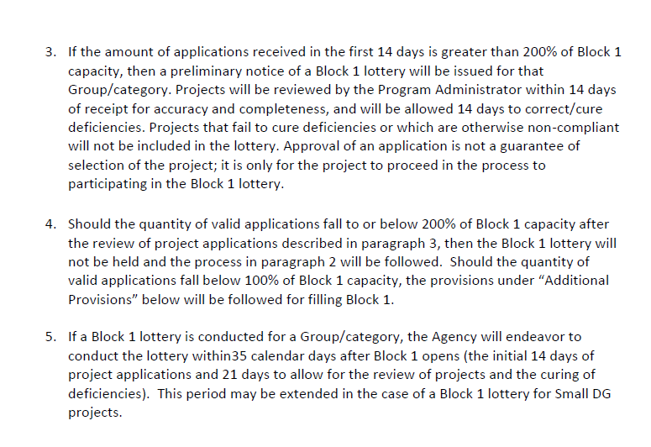
Proposal

Slide 7
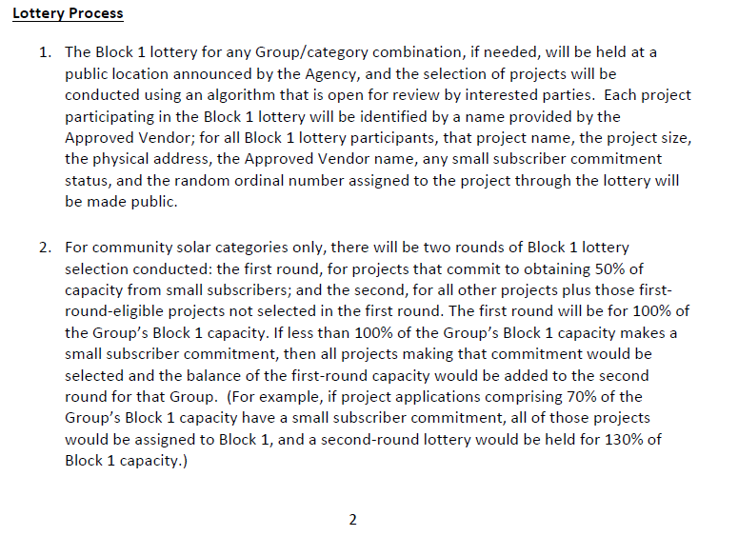
Proposal

Slide 8
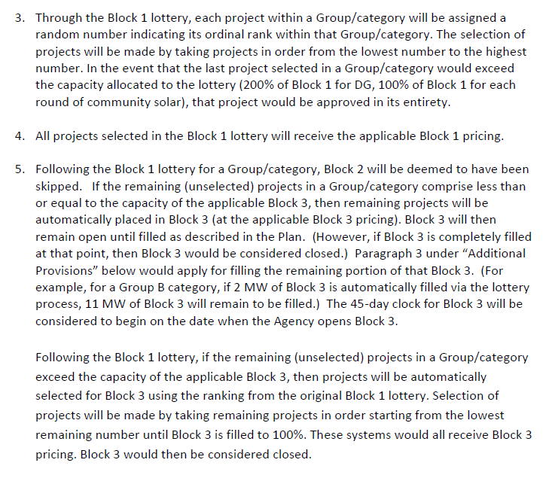
Proposal

Slide 9
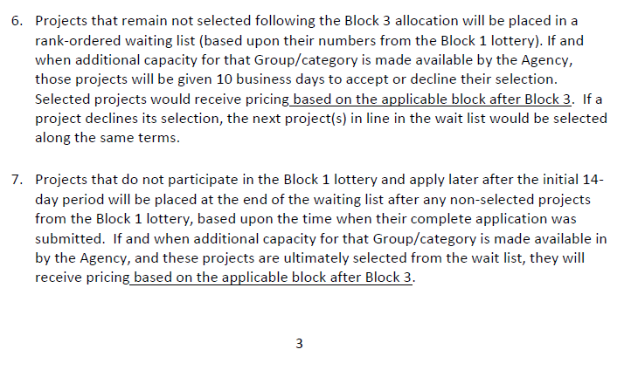
Proposal

Slide 10
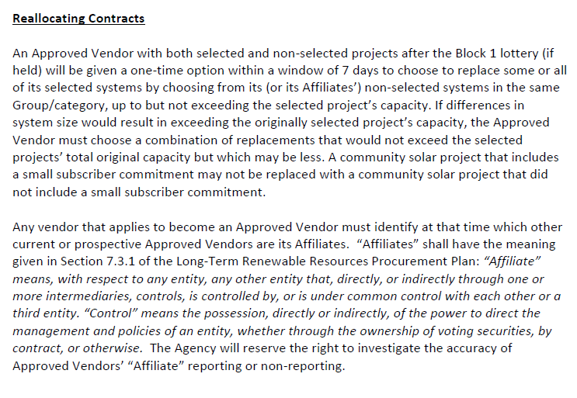
Proposal

Slide 11
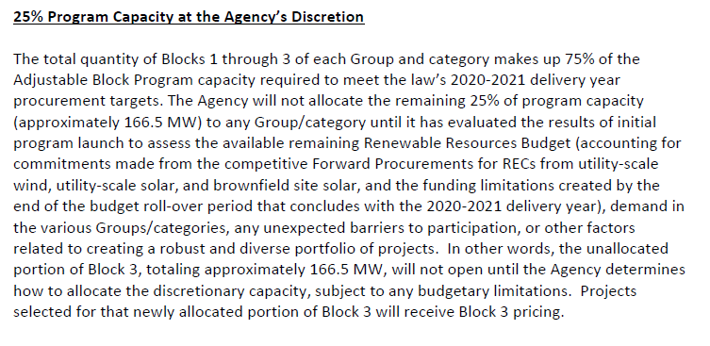
Proposal

Slide 12
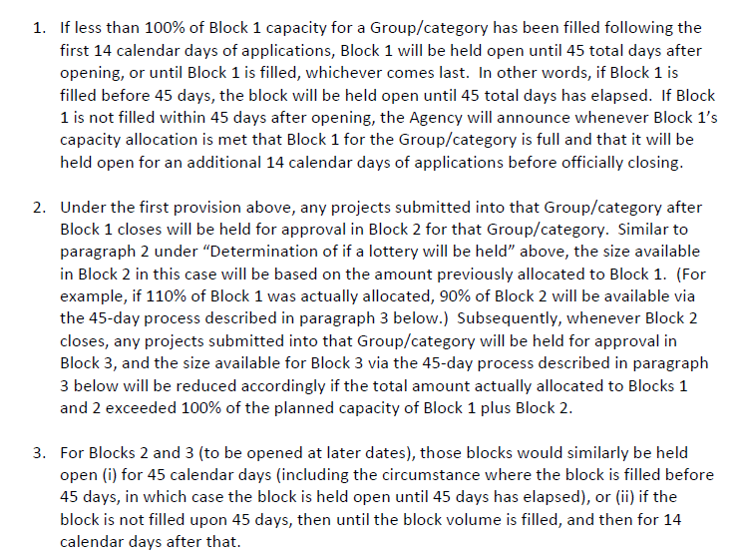
Proposal

Slide 13
Comments to
comments@illinoisabp.com
By 5:00 PM Central Time
Sep 28th, 2018
All comments received will be made publicly available unless the commenter specifically requests confidential treatment and submits a confidential and redacted version.

